Slide 1
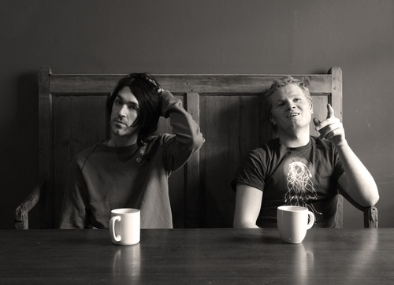
Duologues & sCENES
Drama
Year 9
Lesson 4 Characterisation

Slide 2

LESSON AIM
To investigate the characterisation of a role.

Slide 3
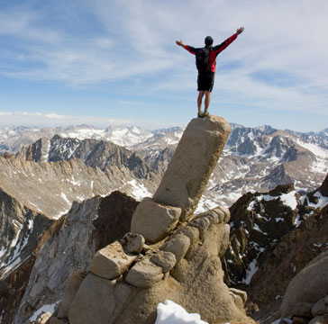
LESSON OUTCOME
LEVEL 4 – I will know what CHARACTER means.
LEVEL 5 – I will know what CHARACTER means and understand how it can be explored through Drama strategies.
LEVEL 6 – I will be able to show my understanding of my CHARACTER by effectively implementing it within my performance in a Drama scene.

Slide 4

NUMBER YOURSELF
Get into groups of 4 or 5.
Count how many people are in your group.
If there are 4 people in your group number yourselves 1,2, 3 and 4.
If there are 5 people then number yourselves 1-5 etc

Slide 5
SOCIAL ROLES
In your next task you will be given specific roles, they are assigned by the numbers you have chosen below:
THE RECORDER – Recording Ideas
THE FOCUS KEEPER – Staying On Task
THE PRAISER – Praising, Complimenting
THE CHECKER – Checking for Understanding
THE ENCOURAGER – Encouraging, Motivating

Slide 6
MIND MAPPING
In groups of 4 or 5 Mind Map the word CHARACTER on a large piece of paper.
What do you think of?
Write down as much as you can.
Work Cooperatively
Remember your individual roles within the group.
THE RECORDER – Recording Ideas
THE FOCUS KEEPER – Staying On Task
THE PRAISER – Praising, Complimenting
THE CHECKER – Checking for Understanding
THE ENCOURAGER – Encouraging, Motivating

Slide 7

CAROUSEL ROTATION
Each group will rotate around the room and look at another groups Mind Map.
This will happen under three signals.
The quiet signal
“Move to the group to the right”
“One minute to investigate”

Slide 8
CHARACTER
The aggregate of features and traits that form the individual nature of some person or thing.
One such feature or trait; characteristic.
Moral or ethical quality: a man of fine, honourable character.
Qualities of honesty, courage, or the like; integrity: It takes character to face up to a bully.
An account of the qualities or peculiarities of a person or thing.
A person represented in a drama, story, etc

Slide 9

CHOICES
In Drama we make CHOICES about the characters and how we play them.
These CHOICES should be formed through logical decisions such as...
Information discovered in the script.
The way the words are written in the script.
The home of the character.
What the character says about him/herself
What other people say about the character

Slide 10

RACE OF LIFE
Class is split into two groups, A & B.
Group A sit and watch, Group B race.
In slow motion students will move from one side of the room to the other.
Students must change their physicality to match the stage of life as the teacher calls them out.
Swap over groups and repeat exercise
STAGES OF LIFE – BABY, SMALL CHILD, TEENAGER, A YOUNG ADULT, MIDDLE AGED PERSON, AN OLD PERSON.
One student will go into the circle and do a mime to get the rest of the students to guess what they are miming.

Slide 11

TIMED PAIR SHARE
Teacher announces the topic and tells you how long each of you will have.
Teacher gives you “think time”.
In pairs, Partner A shares as Partner B listens.
Teacher calls “time”.
Partner B thanks and praises Partner A.
Partners switch roles.

Slide 12
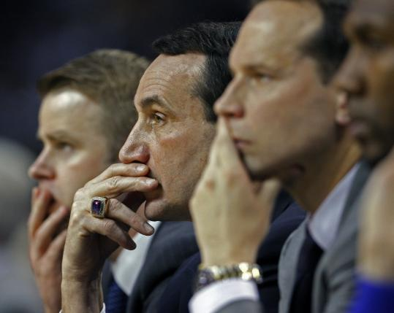
STILL IMAGES
Group A are to start this activity, group B are to sit, watch and evaluate.
Create a Still Image of a person who...
Is contented with his life
Is alone in this world
Is shy and reserved

Slide 13
STILL IMAGES
Group B are to start this activity, group A are to sit, watch and evaluate.
Create a Still Image of a person who...
Works hard everyday
Suffers from a bad back
Is full of life

Slide 14
PHYSICALITY
Everybody carries themselves in a different way.
A persons physicality is unique to them and is normally formed through inner feelings, habits, subconscious movements or conscious decisions.
One university study indicated that up to 93% of communication effectiveness is determined by nonverbal cues.
YOUR BODY SAYS SO MUCH AND IS READABLE...THIS IS WHY YOU SHOULD NEVER LIE TO YOUR TEACHER. ☺

Slide 15
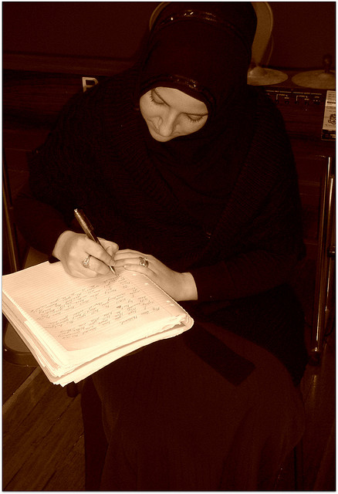
WRITING IN ROLE
Imagine you are the character from your scene and you have suddenly had to move abroad to the other side of the world.
Write a letter to someone ‘In Role’, be your character as you write the letter .
If you need help writing your letter use the remember starters below
Remember to tell the person...
how you are feeling
Why you are feeling this way
What matters to you
Why do these things matters

Slide 16

CIRCLE TIME
Sit in whole class circle.
Discuss what we have learnt about character and characterisation.

Slide 17
What did you achieve today? LESSON OUTCOME
LEVEL 4 – I will know what CHARACTER means.
LEVEL 5 – I will know what CHARACTER means and understand how it can be explored through Drama strategies.
LEVEL 6 – I will be able to show my understanding of my CHARACTER by effectively implementing it within my performance in a Drama scene.

Slide 18
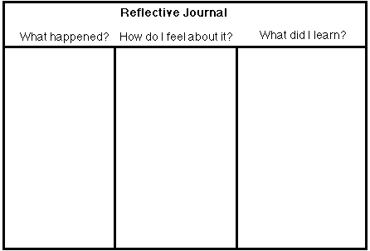
REFLECTIVE LOG
It is important to reflect on every lesson and begin thinking about setting targets for yourselves. For assessment it is important to keep a log book of activities, so you must write a reflective log for each lesson.

